Slide 1


PROJECT TITLE :- “Heart Disease Prediction System Using Machine learning” GUIDE NAME: Prof. Sarjare .M. D
Navashyadri Groups of Institute Faculty of Engineering
ACADEMIC YEAR 2024-25
DEPARTMENT OF AI & ML ENGINEERING

Slide 2
GROUP MEMBER :-
Roll No. | PRN No. | Name
1 | 7221408C | Shreya Shingate
2 | 7221405J | Sakshi Shimpi
3 | 72259406C | Zeeshan Shaikh

Slide 3
CONTENTS :-
INTRODUCTION
LITERATURE REVIEW
OBJECTIVES
METHODOLOGY
BLOCK DIAGRAM
IMPLEMENTATION
ADVANTAGES
APPLICATIONS
FUTURE SCOPE
REFERENCES

Slide 4
1. INTRODUCTION:-
The general term used to cover malfunctions or irregularities of the heart is Heart Disease, or sometimes Cardiac Disease.
Although heart disease can occur in different forms, there is a common set of core risk factors that influence whether someone will ultimately be at risk for heart disease or not
As further symptoms are considered, they can include:
Chest pain, chest tightness, chest pressure and discomfort in chest (angina).
Shortness of breath even during light activities.
Pain, numbness, weakness or coldness in your legs or arms if the blood vessels in those parts of your body are narrowed.
Infants may experience shortness of breath during feedings, leading to poor weight gain and physical ailments.
Severe Continuous pain in the neck, throat , back of abdomen.
Access adipose tissue, elevated blood pressure levels and elevated cholesterol levels.

Slide 5
2. LITERATURE REVIEW:-
NO. | PROJECT TITLE | LITERATURE REVIEW
2.1 | Predicting the Risk of Heart Failure With EHR Sequential Data Modelling | Bo Jin, Chao Che et al. (2020) proposed a “Predicting the Risk of Heart Failure With EHR Sequential Data Modelling” model designed by applying neural network. We tend to used one-hot encryption and word vectors to model the diagnosing events and foretold coronary failure events victimization the essential principles of an extended memory network model. [3].
2.2 | An Intelligent Learning System based on Random Search Algorithm and Optimized Random Forest Model for Improved Heart Disease Detection | Ashir Javeed, Shijie Zhou et al. (2022) designed “An Intelligent Learning System based on Random Search Algorithm and Optimized Random Forest Model for Improved Heart Disease Detection”. This paper uses random search algorithm (RSA) for factor selection and random forest model for diagnosing the cardiovascular disease. [4]
2.3 | Early and accurate detection and diagnosis of heart disease using intelligent computational model. | Early and accurate detection and diagnosis of heart disease using intelligent computational model. [Yar Muhammad] , MuhammadTahir1 , Maqsood Hayat1,KilTo Chong[5]

Slide 6
3. OBJECTIVES :-
Data Collection and Preprocessing
Feature Selection and Engineering
Model Selection and Development
Model Training and Evaluation
Building a Prediction System

Slide 7
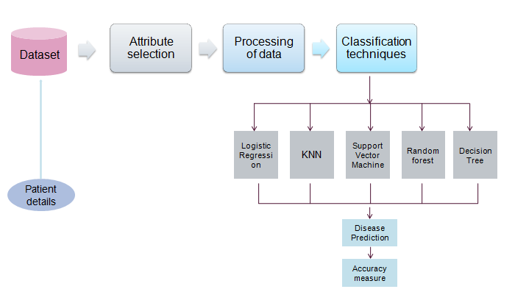
4. METHODOLOGY

Slide 8
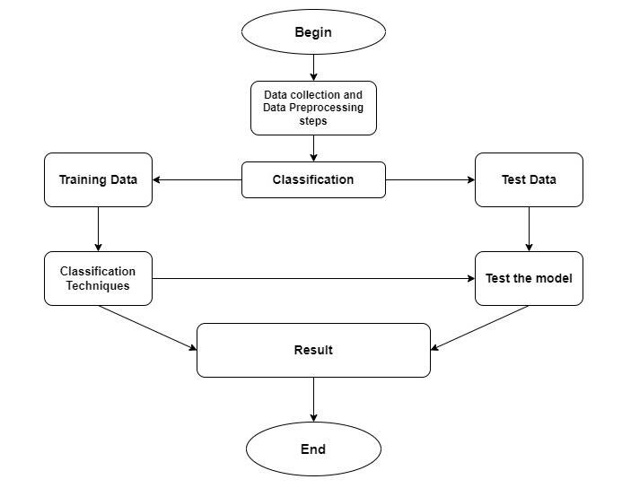
5. BLOCK DIAGRAM :-

Slide 9
6. ADVANTAGE :-
Early Detection of Heart Disease
Improved Accuracy
Personalized Healthcare
Reduced Healthcare Costs
Real-Time Prediction

Slide 10
7. APPLICATION :-
Machine learning models can analyze a patient’s medical history, lifestyle factors, and test results to predict the likelihood of heart disease.
Healthcare providers can use machine learning models to predict the likelihood of heart disease in patients, aiding doctors in identifying at-risk individuals.
Mobile applications that use machine learning to predict heart disease risk based on inputs such as age, blood pressure, cholesterol levels, family history, and lifestyle

Slide 11
8. FUTURE SCOPE:-
Distribution of Heart Disease Risk
The Distribution of Heart Disease Risk will represent how the predicted risk levels are distributed among patients based on their health data. By categorizing patients into High Risk, Moderate Risk, and Low Risk, you can visually show how many individuals fall into each group, using a pie chart or bar graph. This distribution will be based on key factors such as cholesterol levels, blood pressure, age, and other predictive health markers. Visualizing this distribution helps to quickly communicate the results of the prediction model, allowing healthcare providers to prioritize patients for intervention or follow-up care. It also serves as a useful tool for patients to better understand their individual risk level and take necessary precautions.

Slide 12
9.REFERENCES :-
Bo Jin ,Chao Che, Zhen Liu, Shulong Zhang, Xiaomeng Yin,And Xiaopeng Wei, “Predicting the Risk of Heart Failure WithEHR Sequential Data Modeling” ,IEEE Access 2018.
Ashir Javeed, Shijie Zhou, Liao Yongjian, Iqbal Qasim,Adeeb Noor, Redhwan Nour4, Samad Wali And Abdul Basit ,“An Intelligent Learning System based on Random SearchAlgorithm and Optimized Random Forest Model forImproved Heart Disease Detection” , IEEE Access 2017.

Slide 13
THANK YOU…

